Slide 1
Crash Course on Containers!
Instructor: Jim Crowley
Marist Capping

Slide 2
Table of Contents
What are Containers?
Containerization Technology
Containers vs Virtual Machines
Docker, Podman and Open Container Initiative (OCI)
Why do we use Containers?
Lightweight Virtualization
Environment Isolation
Standardized Packaging and Deployment
Scalability and Microservices
Beyond Containers
Docker-Compose, Swarm, and Kubernetes
How do we use Containers?
Dockerfiles
Images
Registries
Containers
Volumes
Manifests
Docker-Compose

Slide 3
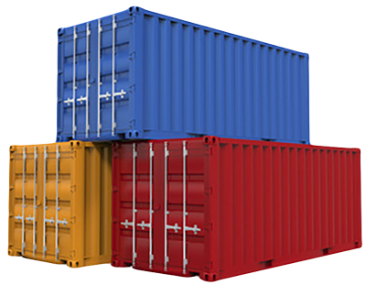
Containerization Technology
Encapsulating or packaging up software code and all its dependencies so that it can run uniformly and consistently on any infrastructure
Allows applications to run in isolated user spaces (aka containers) using preexisting Linux features: cgroups & namespaces
Breaking down monolith applications into their components

Slide 4
Containers vs Virtual Machines
Virtual Machines (VMs) are a hard virtualization technology that allow you to fully virtualize the hardware and resources of a computer
A hypervisor is responsible for starting, stopping and managing the lifecycle of virtual machines

Slide 5

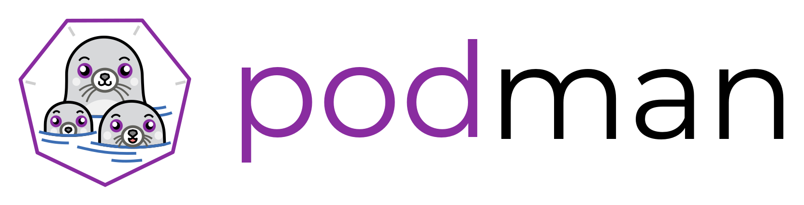
Docker, Podman and Open Container Initiative
Docker and Podman are just implementations of Linux cgroups and namespaces
Docker was first on the scene on March of 2013. The Docker team established:
Standardized Container Format
Tools for developers to build container – Dockerfiles
Tools for running and managing containers – Docker Daemon, Docker Compose, Docker Swarm
Podman was launched on August of 2018. Aims to improve on Docker in the following ways:
Better default security i.e. does not allow containers to run as root
Removed the need for a daemon
Supports the Open Container Initiative (OCI)

Slide 6
Why do we use Containers?

Slide 7
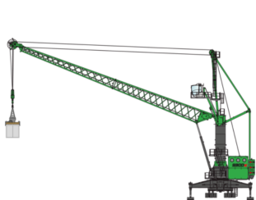
Lightweight Virtualization
Containers are extremely lightweight
Utilizes the host system’s kernel and runs as a compartmentalized process within that OS
Containers are “essentially” just like any other process on the host OS
Images files can be very small compared to bulky VMs (Windows is ~32GBs for the OS)

Slide 8
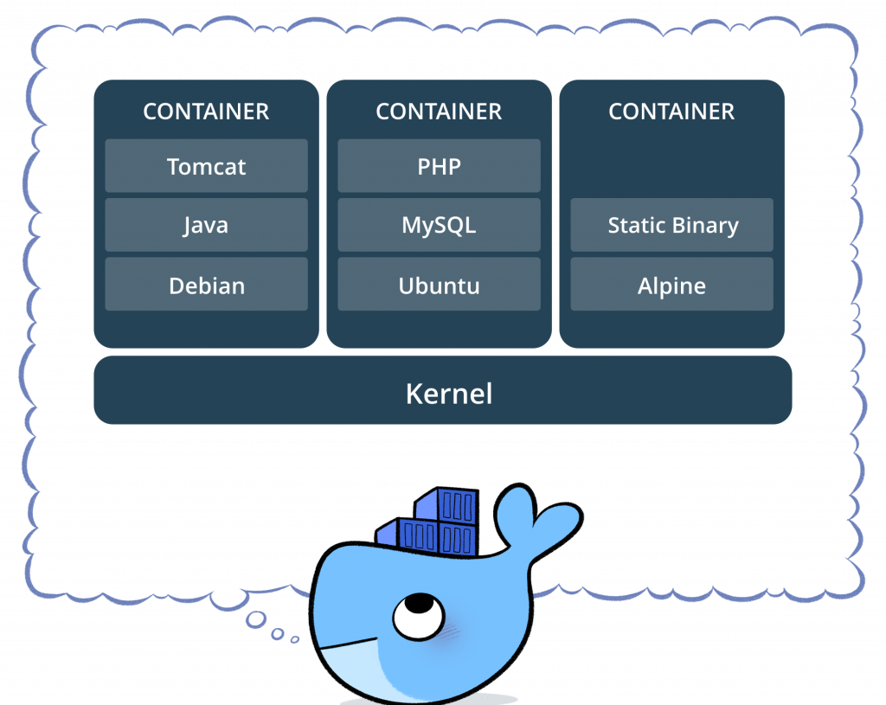
Environmental Isolation
Allows for multiple applications to run on the same system without interfering with each other
Dependency and system library conflicts are easily avoid since each container has a separate filesystem
Provides some layer of security but is not a full fledge sandbox environment

Slide 9
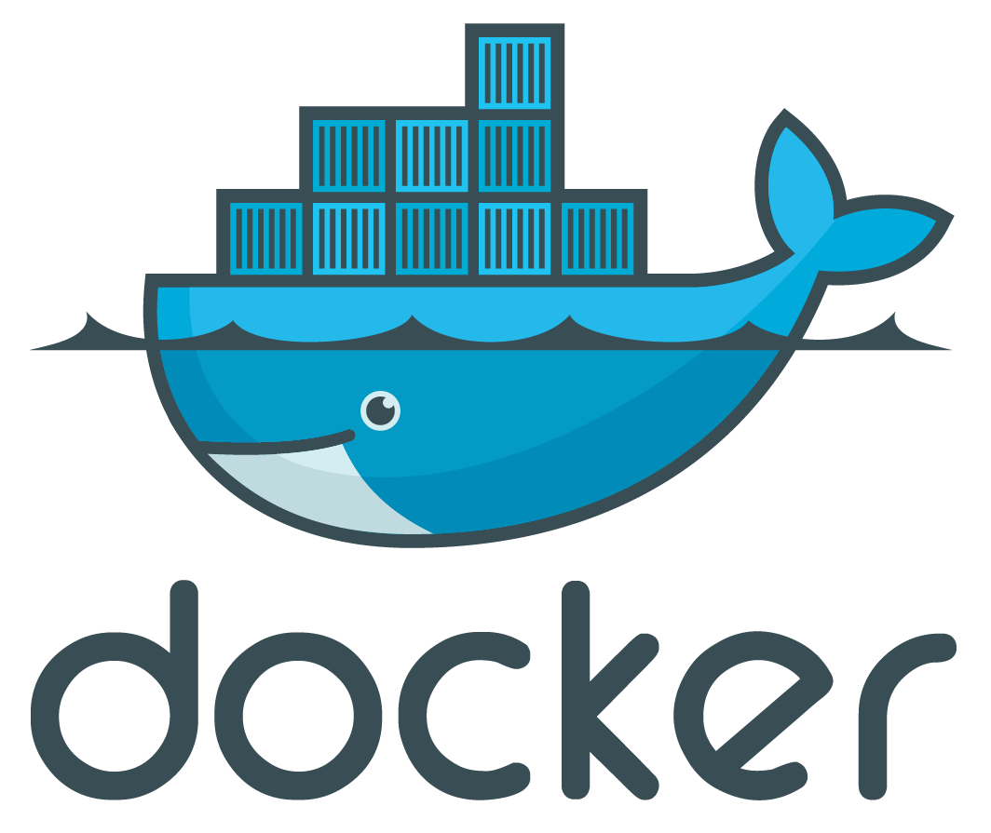
Standardized Packaging and Deployment
Provides a repeatable and reliable way to deploy applications
Gone are the days with messing around with installing certain versions of packages on system to deploy your application
Easy for developers and companies to distribute their software with minimal user knowledge

Slide 10

Scalability and Microservices
Microservices is an architectural design for building distributed applications.
Breaks monolithic applications into their individual services
Databases, Backend, API, Frontend, etc.
Breaking applications into individual components allow for scaling of specific services
Scalability allows for flexible configurations and environments

Slide 11
Beyond Containers!

Slide 12
Docker-Compose, Swarm and Kubernetes
Docker Compose is a tool for defining and running multi-container applications
Allows you to deploy a full stack application (Database, Backend, API and Frontend) all in one command using a single YAML file
Super useful for smaller deployments
Docker Swarm allows for small scale orchestration of containers on multiple nodes (computers)
Kubernetes is a production ready application to deploy your containers
Allows for orchestration of containers
Allows for a cloud like environment that support multi-tenants

Slide 13
How do we use Containers?

Slide 14
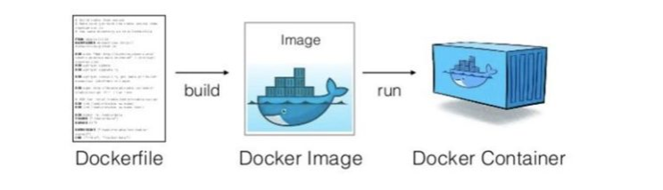
Dockerfiles
A simple text file that is used as assembly instructions to build your images
Uses Docker keywords to perform actions
ADD – Adds files from your local system into the Docker file system
FROM – Imports another Docker Image as your base
RUN - Runs standard Linux commands (Bash, apt-get, tar, etc.)
Plus Many More!
FROM – Inheritances/Pulling from another image
Controls what your entry point is and what programs/scripts to run on start

Slide 15
Images
A redeployable “blueprints” to construct a container
Immutable file
Made up of layers
A layer is a certain command in a Dockerfile. Each layer is a snapshot of the action. Each layer adds to the overall image.
Portable
Contains all binaries, runtime environments, etc.
Docker Commands:
docker build

Slide 16
Registries
A centralized place for storing images
Allows user to pull images down for use and push image up for publishing
Most common registries are:
DockerHub - Docker
Quay.io – RedHats (Podman)
Tagging images allow you to mark certain version/variants
Private registries exist for hosting images internal to a company
Artifactory & Harbor
Docker Commands:
docker tag
docker pull/push
Docker login/logout

Slide 17
Containers
A running instance of an image
Containers do not modify the original image
Self-sufficient
Performs a unit of work. Once the unit of work is done the container with die ☹
Docker Commands:
docker run
docker stop
docker exec
docker logs

Slide 18
Volumes
Volumes allow for persistent storage for a container
Cuts down on the image size
Share files among multiple containers
Backups, restore and migration options
Docker Commands:
docker volume create
docker run ……. –mount
docker run ……. -v

Slide 19
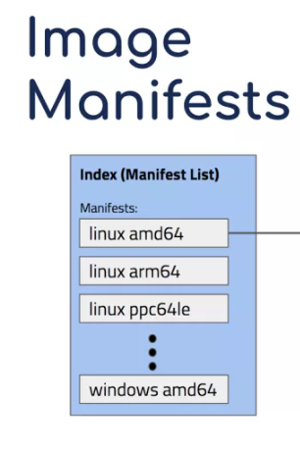
Manifests
A list of metadata on images
Allows for a “super image” which enables support for multi-arch support
Arm
s390x (Z/Mainframe)
ppc64le (Power PC)
amd64 (x86/x64 PCs)
Docker Commands:
docker manifest create
docker manifest inspect
docker manifest annotate
docker manifest push

Slide 20
Docker-Compose
A tool for defining and running multi-container applications
Database, Backend, API, Frontend
Has additional syntax (keywords) for added functionality such as:
Networking (Connecting containers together so they can communicate)
Storage – Allows for persistent volumes specific to your deployment
Expose ports to allow you access frontends via X.X.X.X:8080 or X.X.X.X:XXXX
Used for small deployments, not meant for large scale environments
Docker Commands:
docker-compose up
docker-compose down
Docker-compose up –d (Starts containers in the background)

Slide 21
Questions?

